Slide 1
An Introduction to the ACGME
Dean Seehusen, MD, MPH
Associate Dean for Graduate Medical Education
Professor of Family Medicine

Slide 2
Learning Objectives
Upon completion of this session, participants should be able to:
Define common terms associated with the ACGME accreditation process
Describe the modern accreditation cycle
Describe the current state of competency-based evaluation of medical learners
Define the purpose of the Program Evaluation Committee and Clinical Competency Committee

Slide 3
Agenda
What is the ACGME
Accreditation Overview
Next Accreditation System
Daily Influence
ACGME Website Introduction
The Future of the ACGME

Slide 4
The ACGME

Slide 5
What is the ACGME?
A private 501(c)(3) not-for-profit organization
Established in 1981
The ACGME has seven member organizations:
  American Board of Medical Specialties (ABMS)
  American Hospital Association (AHA)
  American Medical Association (AMA)
  Association of American Medical Colleges (AAMC)
  Council of Medical Specialty Societies (CMSS)
  American Osteopathic Association (AOA) [2014]
  American Association of Colleges of Osteopathic Medicine (AACOM) [2014]
Accreditation is voluntary
WWW.ACGME.ORG.

Slide 6
ACGME Mission and Purpose
Mission
  We improve health care and population health by assessing and advancing the quality of resident physicians' education through accreditation.
The ACGME has a twofold purpose:
  (1) to establish and maintain accreditation standards that promote the educational quality of residency and subspecialty training programs; and
  (2) to promote conduct of the residency educational mission with sensitivity to the safety of care rendered to patients and in a humane environment that fosters the welfare, learning, and professionalism of residents.
WWW.ACGME.ORG.

Slide 7
ACGME Vision
“We imagine a world characterized by:
  A structured approach to evaluating the competency of all residents and fellows,
  Motivated physician role models leading all GME programs,
  High-quality, supervised, humanistic clinical educational experience, with customized formative feedback,
  Clinical learning environments characterized by excellence in clinical care, safety, and professionalism,
  Residents and fellows achieving specialty specific proficiency prior to graduation
  Residents and fellows prepared to become Virtuous Physicians who place the needs and well-being of patients first”
WWW.ACGME.ORG.

Slide 8
Accreditation Overview

Slide 9
Accreditation Overview
The ACGME creates and publishes requirements
Institutions and programs implement the requirements then document and report outcomes
The ACGME monitors compliance
  Accredits programs in substantial compliance
  Provides feedback on specific areas for improvement
  Withholds accreditation for significant noncompliance

Slide 10
Levels of Requirements
Institutional Requirements
  Institutional leadership
  DIO
Common Program Requirements
  One-year Common Program Requirements
Specialty-specific Requirements

Slide 11
Review Committees
Accreditation of GME programs is carried out by the Review Committees
Determine and publish accreditation standards for residencies of that specialty
Provides peer evaluation of residency or fellowship programs
Assess whether an institution or program is in substantial compliance with the published set of ACGME educational standards

Slide 12
The Next Accreditation System

Slide 13
Next Accreditation System
Announced in 2012
Threefold aim:
  Enhance the ability of the peer-review system to prepare physicians for practice in the 21st century
  Accelerate the ACGME’s movement towards accreditation based on educational outcomes
  Reduce the burden associated with a process-based approach to accreditation
Visits less frequent but data reported more frequently
  Milestones every 6 months
  ADS annually
CLER introduced
Nasca TJ, Philibert I, Brigham T, Flynn TC. The next GME accreditation system--rationale and benefits. N Engl J Med. 2012 Mar 15;366(11):1051-6.

Slide 14
Accreditation Cycle
Philibert I, Lieh-Lai M. The Program Self-Study in the Next Accreditation System. ACGME Webinar. May 9, 2014.

Slide 15
Accreditation Cycle
Philibert I, Lieh-Lai M. The Program Self-Study in the Next Accreditation System. ACGME Webinar. May 9, 2014.

Slide 16
Ongoing Self-Evaluation
Data collection by programs
  Accreditation Data System (ADS)
  Case Log System
  Milestone reports
Resident/Faculty must have the opportunity to evaluate the program at least annually
Program Evaluation Committee
  Generates the Annual Program Evaluation
  Prepares a plan of action to improve the program
ACGME. Common Program Requirements.

Slide 17
Daily Influence

Slide 18
ACGME Competencies
Patient Care
Medical Knowledge
Practice Based Learning and Improvement
Systems Based Practice
Professionalism
Interpersonal Skills and Communication
WWW.ACGME.ORG.

Slide 19
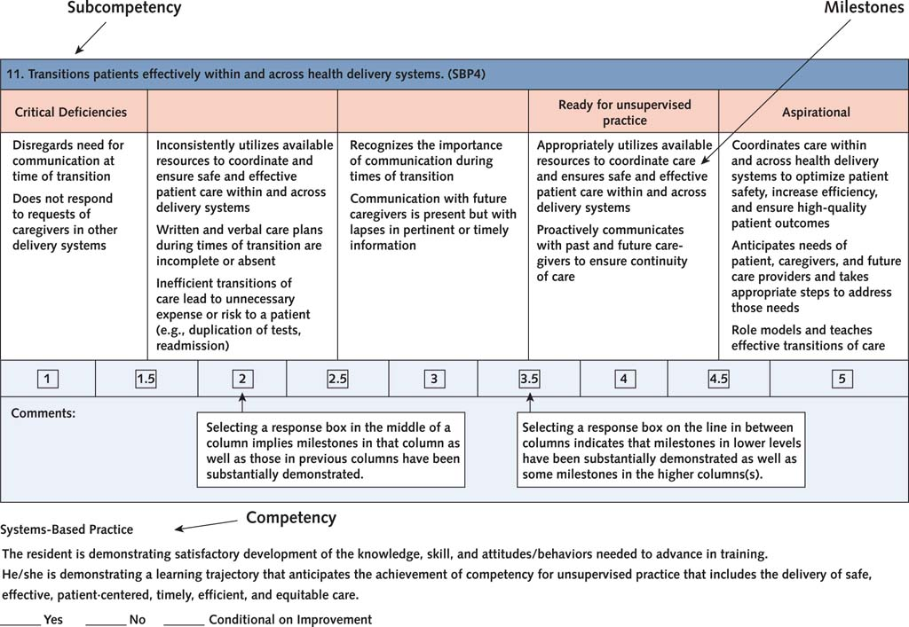

Slide 20
CCC
Clinical Competence Committee (CCC)
Minimum of three faculty members
Duties
  Review all resident evaluations semi-annually
  Prepare Milestone evaluations semi-annually
  Advise the PD regarding resident progress, including promotion (graduation), remediation, dismissal
ACGME. Common Program Requirements.

Slide 21
PEC
Program Evaluation Committee (PEC)
At least 2 faculty and 1 resident/fellow
Duties
  Actively participate in planning, developing, implementing, and evaluating educational activities
  Review and revise curriculum goals and objectives
  Address areas of non-compliance with ACGME standards
  Review the annual program evaluation (APE) in a formal, systematic manner
ACGME. Common Program Requirements.

Slide 22
Online Data Entry
Accreditation Data System (ADS)
  Yearly entry/validation of data to demonstrate a program is meeting requirements
  Similar across all specialties
  Useful for generating reports
Resident Case Log System
  Recording and tracking mechanism for procedures
  More heavily used in surgical subspecialties
WWW.ACGME.ORG.

Slide 23
ACGME Surveys
Resident Surveys
Faculty Surveys
Related to outcomes
  There is a positive correlation between noncompliance reported on resident and faculty surveys and programs with less than 80% ABIM pass rate
Holt KD, Miller RS, Vasilias J, Byrne LM, Cable C, Grosso L, Bellini LM, McDonald FS. Relationships Between the ACGME Resident and Faculty Surveys and Program Pass Rates on the ABIM Internal Medicine Certification Examination. Acad Med. 2018 Aug;93(8):1205-1211.

Slide 24
ACGME Hot Topics
CLER Visits
QIPS
Well-Being
Duty Hours
Supervision
Transitions of Care
Professionalism
Scholarship

Slide 25
Clinical Learning Environment Review (CLER) Visits
Every 24 +/- 6 months
Focused on institutional leadership
Designed to provide periodic feedback that addresses focus areas:
  patient safety
  health care quality
  care transitions
  supervision
  well-being
  professionalism
Results are “fire-walled” off from the ACGME
WWW.ACGME.ORG.

Slide 26

PDSA Cycle
Philibert I, Lieh-Lai M. The Program Self-Study in the Next Accreditation System. ACGME Webinar. May 9, 2014.

Slide 27
ACGME Website Intro

Slide 28

WWW.ACGME.ORG.

Slide 29

WWW.ACGME.ORG.

Slide 30

WWW.ACGME.ORG.

Slide 31
WWW.ACGME.ORG.

Slide 32
The Future of the ACGME

Slide 33
Where is the ACGME going?
Defining educational characteristics of programs that produce high quality physicians
Defining the key indicators of quality and safety that should be used to judge programs and institutions
What threshold should be used to allow a program or institution to train physicians?
Can competency-based training replace time-based training of physicians?
Nasca TJ, Weiss KB, Bagian JP, Brigham TP. The accreditation system after the "next accreditation system". Acad Med. 2014 Jan;89(1):27-9.

Slide 34
Entrustable Professional Activities
The ACGME is now laying the groundwork to move residency programs toward using Entrustable Professional Activities (EPAs) as a core part of resident competency assessment
EPAs are observable activities that are required of practicing physicians
Reflect one or more ACGME competencies
Examples from Internal Medicine:
  Resuscitate, stabilize, and care for unstable or critically ill patients
  Manage care of patients with chronic diseases across multiple care settings.
  Demonstrate professional behavior
Caverzagie KJ, Cooney TG, Hemmer PA, Berkowitz L. The development of entrustable professional activities for internal medicine residency training: a report from the Education Redesign Committee of the Alliance for Academic Internal Medicine. Acad Med. 2015;90(4):479-84.

Slide 35
Learning Objectives
Upon completion of this session, participants should be able to:
Define common terms associated with the ACGME accreditation process
Describe the modern accreditation cycle
Describe the current state of competency-based evaluation of medical learners
Define the purpose of the Program Evaluation Committee and Clinical Competency Committee

Slide 36
Bibliography

Slide 37
Bibliography
Nasca TJ, Philibert I, Brigham T, Flynn TC. The next GME accreditation system--rationale and benefits. N Engl J Med. 2012 Mar 15;366(11):1051-6.
Nasca TJ, Weiss KB, Bagian JP, Brigham TP. The accreditation system after the "next accreditation system". Acad Med. 2014 Jan;89(1):27-9.
Accreditation Council for Graduate Medical Education. Available at: https://www.acgme.org/
Holt KD, Miller RS, Vasilias J, Byrne LM, Cable C, Grosso L, Bellini LM, McDonald FS. Relationships Between the ACGME Resident and Faculty Surveys and Program Pass Rates on the ABIM Internal Medicine Certification Examination. Acad Med. 2018 Aug;93(8):1205-1211.
Philibert I, Nasca TJ. The Program Self-Study and the 10-Year Site Visit: Rationale for a New Approach. J Grad Med Educ. 2015 Jun;7(2):310-2.

Slide 38
Bibliography
Philibert I, Lieh-Lai M. The Program Self-Study in the Next Accreditation System. ACGME Webinar. May 9, 2014. Available at: https://www.acgme.org/Portals/0/PDFs/Webinars/May09SelfStudy.pdf?ver=2015-11-06-120543-130
Philibert I, Nasca TJ. The Program Self-Study and the 10-Year Site Visit: Rationale for a New Approach. J Grad Med Educ. 2015 Jun;7(2):310-2.
ACGME. Common Program Requirements. Available online at: https://www.acgme.org/Portals/0/PFAssets/ProgramRequirements/CPRs_2017-07-01.pdf
Caverzagie KJ, Cooney TG, Hemmer PA, Berkowitz L. The development of entrustable professional activities for internal medicine residency training: a report from the Education Redesign Committee of the Alliance for Academic Internal Medicine. Acad Med. 2015;90(4):479-84.

